Slide 1


Multilingual Author Profiling On SMS(Short Message Service)
Guided By:
Dr. Hiren Joshi
Dr. Hardik Joshi
Prepared By:
Shifa Khan
Aatithya Hitkar

Slide 2
Dissertation

Slide 3
Index
Sr. No. | Topic
1 | Research Problem
2 | Terminologies Multilingual Author Profiling Multilingual Author Profiling on SMS
3 | Applications
4 | FIRE
5 | Dataset Classification
6 | Sample Data
7 | Tags Identification
8 | Different Approaches
9 | Flow chart
10 | CSV File
11 | Raw Data
12 | Tokenization

Slide 4
Index
Sr. No. | Topic
13 | Pre-processing of data
14 | Pre-processed data
15 | Tokenization after Pre-Processing of data
16 | TFIDF
17 | N-gram
18 | Naïve Bayes
19 | SVM – Support vector machine
20 | Decision Tree
21 | Random Forest
22 | Evaluation measures
23 | Accuracy comparison
24 | Literature Review
25 | Conclusion
26 | Future Work
27 | References

Slide 5
Research Problem
We aim to find the Author’s Age and Gender from the messages which are written in Roman Hindi and English.
Gender Identification :
To classify the multilingual author to Male or Female
Age Identification :
To classify the multilingual author profile into one of the three categories. 15-19, 20-24, 25-XX.

Slide 6
What is Multilingual ?
Using more than one language in communication.
Co-presence of two or more languages in a text, speech or society.
Example : Hindi – English, Hindi – Gujarati, Gujarati - English.

Slide 7
What is Author Profiling ?
“A text Classification technique that is used to predict the profiling characteristics of the authors like gender, age, native language and educational background by analyzing their text.”- Álvarez-Carmona
Based on stylistic and content-based features.
The task of author profiling was given as student task at PAN and FIRE.

Slide 8
Multilingual Author Profiling On SMS
Finding demographic features like age, gender, native language of an author from the written text.
We will be using Roman Hindi and English as our Multilingual Data.
Roman Hindi(written using English Alphabets) is used in daily communication by a large number of people. It is used in comments, Tweets, Blogs, SMS-messages etc.
Majority of the research on Author Profiling is done for English, Spanish, Italian and Dutch Language.

Slide 9
Applications
Applications:
It can be used in forensics to find the suspect.
It can be used to find out the Fake Profile Identification.
It can also be used in security and marketing.

Slide 10
What is FIRE ?
Forum for Information Retrieval Evaluation
FIRE has evolved continuously to meet the new challenges in multilingual information access.
FIRE include new domains like plagiarism detection, legal information access, mixed script information retrieval and spoken document retrieval to name a few.

Slide 11
Dataset Classification
We will be using the Dataset provided by the FIRE2018.
Age Group | Gender |  | TOTAL
 | Male | Female
15-19 | 70 | 38 | 108
20-24 | 112 | 64 | 176
25- XX | 28 | 38 | 66
TOTAL | 210 | 140 | 350

Slide 12
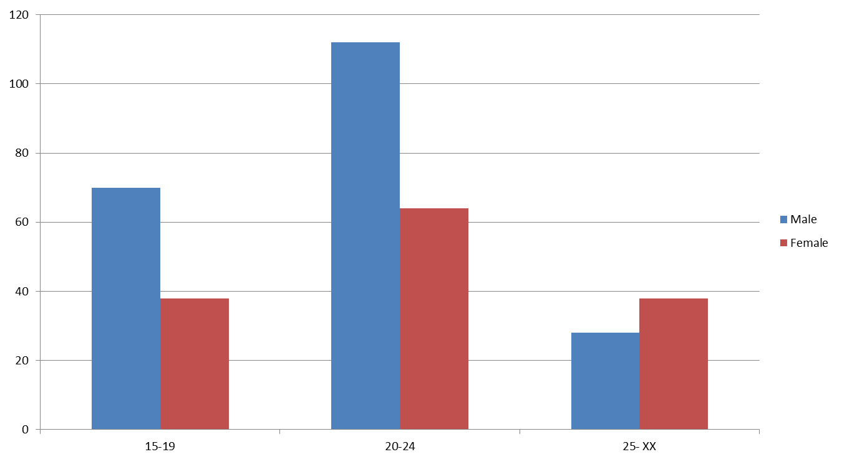
Dataset Classification
No of authors
Age group

Slide 13
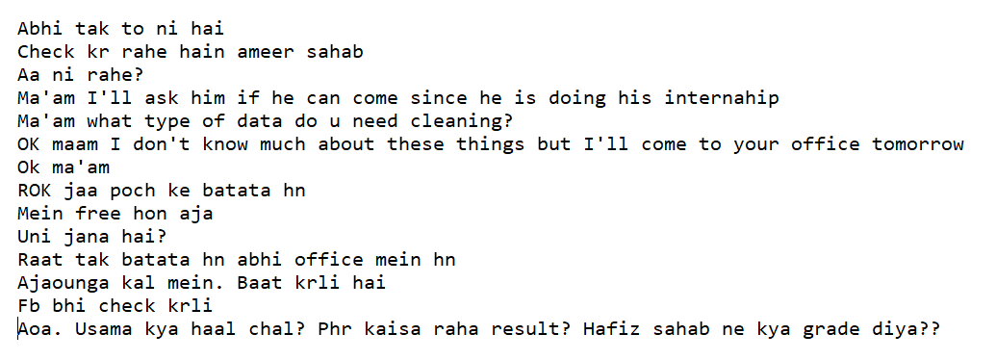
Sample Data : Male

Slide 14
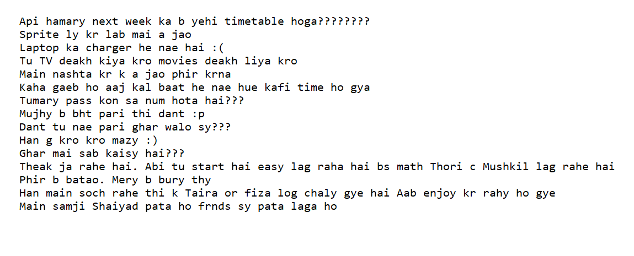
Sample Data : Female

Slide 15
Tags identification
We had identified the following 8 tags for our corpus:
Roman Hindi
English
Named Entity
Numeric
Punctuation
Symbol
Expression
Emoticon

Slide 16
Roman Hindi
1) Roman Hindi:
The example of Hindi based words are “kya”, “raat”, “din”, “subha” and so on.
English words are part of the Hindi vocabulary as well, sometimes in same meanings and sometimes in different meanings.
For Example,
‘main jaon?’ where ‘main’ is an English word, however, it is representing a Roman Hindi word in this sentence.

Slide 17
English
2) English:
Example : ‘Reached’, ‘Home’, ‘While’ and so on.
Abbreviation refers to a short form of a word or phrase.
Example :
‘jk ’ can be used as descriptor in place of ‘just kidding’
‘btw’ can be used as abbreviation in place of ‘by the way’
‘DIY ’ for ‘do it yourself ’ etc.

Slide 18
Named Entity
3) Named Entity:
The names of people and places belong to this category.
Example :
‘Karan ’ is a masculine name.
‘Kareena’ is a feminine name.
‘Jawahar Chowk’ is a place name.
‘Surat’ is a city name.
‘C6’ is the room number in block C.
‘GU’ is abbreviated form of Gujarat University name etc.

Slide 19
Numeric
4) Numeric:
Date, time and number strings are included in this category.
Example :
‘5pm’
‘10-May’
‘6/10 ’
‘3214504500 ’ etc.

Slide 20
Punctuation
5) Punctuation:
This denotes the punctuation symbols such as ‘?’, ‘.’, ‘,’,‘! ’ and so on.
The repetition of punctuation marks is also included in this category.
Example :
‘enjoying?????’
here ‘?????’ etc.

Slide 21
Symbol
6) Symbol:
In this, special characters and their repetitions are included.
Example :
‘$$$$’
‘#’
‘@’ and so on.

Slide 22
Expression
7) Expression:
Sound expressions are distinguishing features of SMS language
Which refer to natural or sometimes non-human sounds representing expressions.
Example :
‘hahaha’ and ‘hehehe’ are used to represent laughter and joy.

Slide 23
Emoticons
8) Emoticon:
It refers to the facial expressions of human beings
Example :
‘ : ( ’ For sadness
‘ :) ’ For smile
‘ o.O ’ or ‘ :O ’ For wonder and so on

Slide 24
Different Approaches
Roman Hindi -> Hindi
API and Libraries
Step 1
Transliterate API for Python
Step 2
Natural Language Tool Kit(NLTK)
Shallow Parser - Tagger
CRF-Suite

Slide 25
Different Approaches
Roman Hindi -> English
API and Libraries
Step 1
Google-translate API
Step 2
Natural Language tool-kit
Stanford’s Core NLP Suite
Apache Luecene
Apache OpenNLP

Slide 26
Different Approaches
Roman Hindi
API and Libraries
Step 1
We don’t need to translate our data in any language.
Step 2
Natural Language tool-kit
Stanford’s Core NLP Suite
We are using this approach for our Problem

Slide 27
Flow Chart
Corpus Data
Raw Data
Pre-Processesing
Removal of End Line, Tabs, stopwords and non-ascii characters.
Feature Extraction
Pre-processed Data
Splitting Training and Testing data
Model
Selection
SVM, Naïve Bayes, Decision Tree, Random Forest
Accuracy
Calculated accuracy of testing data
n-gram
Term Frequency Inverse Document Frequency

Slide 28
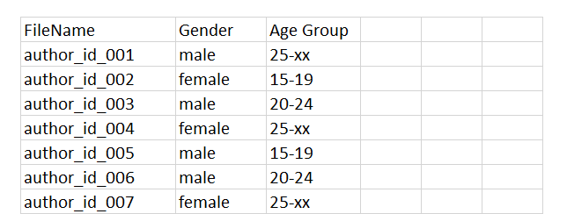
CSV File
We are using pandas for loading data from csv file.

Slide 29
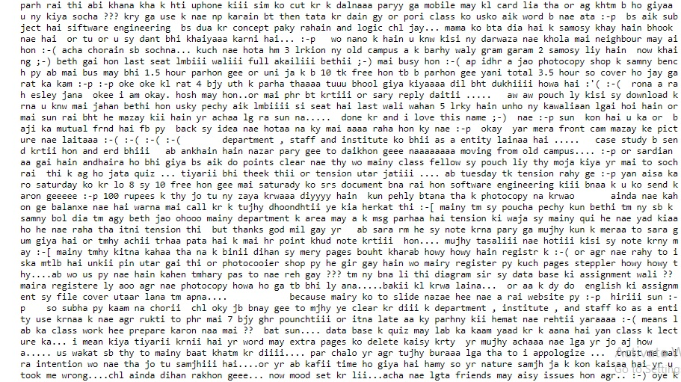
Raw Data

Slide 30
Tokenization
Tokenization is a step which splits longer strings of text into smaller pieces, or tokens.
Larger chunks of text can be tokenized into sentences, sentences can be tokenized into words, etc.
Tokenization is also referred to as text segmentation or lexical analysis.
For our task, we will tokenize our sample text into a list of words.
This is done using NTLK's word_tokenize() function.

Slide 31
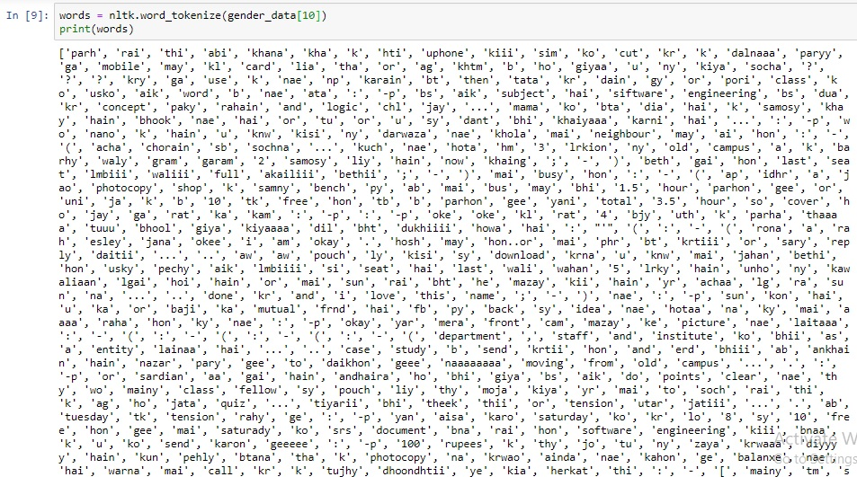
Tokenization

Slide 32
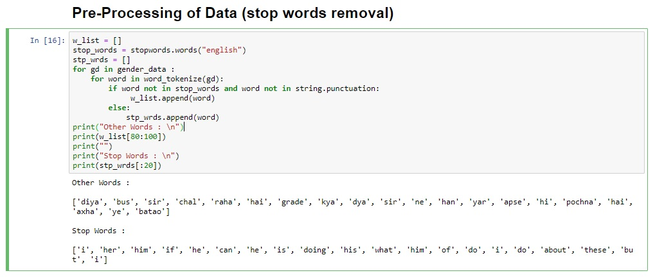
Pre-Processing of Data

Slide 33
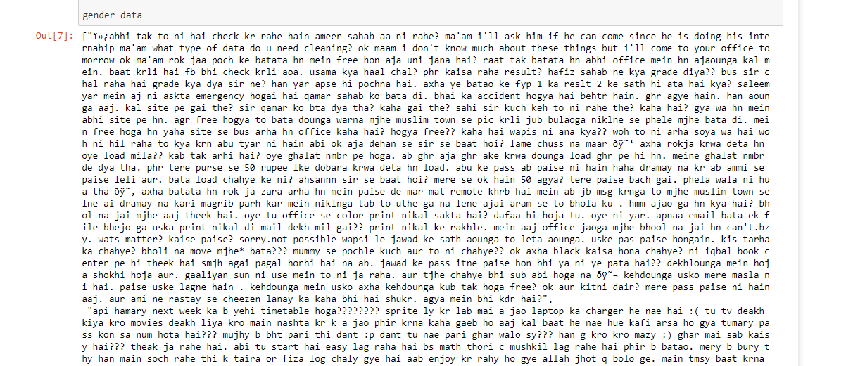
Pre-Processed Data
Removed end lines, tabs, stop words, non-ascii words and the converted to lower case.

Slide 34
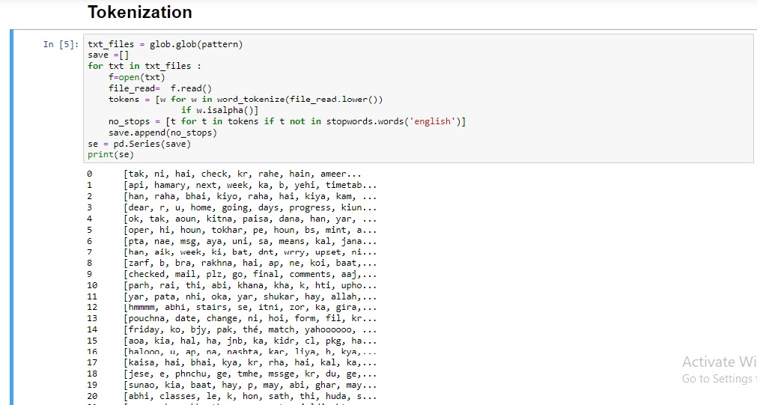
Tokenization – after pre-processing

Slide 35
Term Frequency
Term frequency counts the number of occurrences of term in a text document.
Mathematically it can be represented as:
Term _ Frequency _ Wij = tfij
where, tfij as the frequency of term i in document j
Term Frequency(TF) measures how frequently a term occurs in a document.
TF(t) = (Number of times term t appears in a document) / (Total number of terms in the document)
Total Words in our Corpus –> 2,41,489

Slide 36
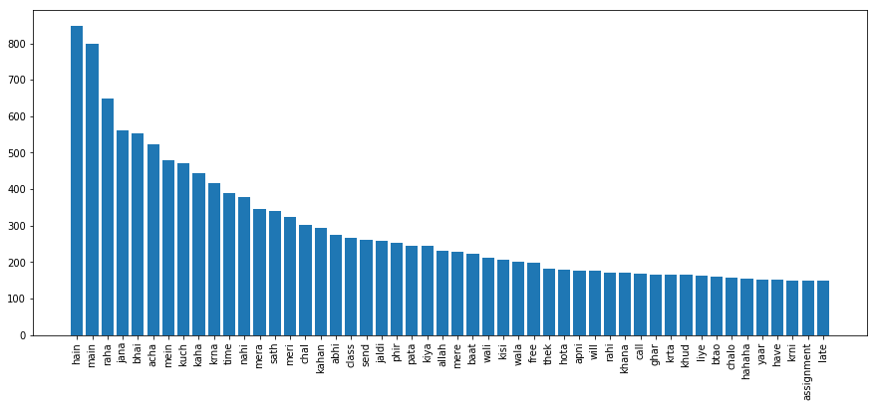
Term Frequency

Slide 37
TFIDF
Inverse Data Frequency (idf): used to calculate the weight of rare words across all documents in the corpus. The words that occur rarely in the corpus have a high IDF score. It is given by the equation below.
IDF(t) = log(Total number of documents / Number of documents with term t in it).
Inverse Document Frequency(IDF) measures how important a term is.
Combining TF and IDF we come up with the TF-IDF score (t) for a term in a document in the corpus. It is the product of tf and idf:
TF-IDF(term) = TF(term in a document) * IDF(term)
TF-IDF gives a numerical value to the importance of each word in a particular text.

Slide 38
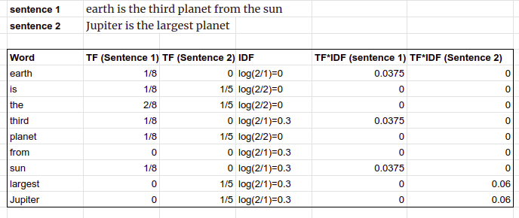
Example : TFIDF
Source - www.simplilearn.com

Slide 39
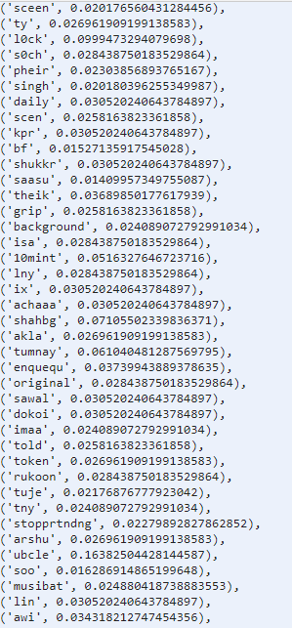
TFIDF – Of Our Dataset

Slide 40

n-Gram
N-grams are basically a set of co-occuring words within a given window and when computing the n-grams you typically move one word forward.
N-grams of texts are extensively used in text mining and natural language processing tasks.
If X=Num of words in a given sentence K, the number of n-grams for sentence K would be:

Slide 41
Example : Bigram
For example, for the sentence "The cow jumps over the moon". If N=2 (known as bigrams), then the n-grams would be:
the cow
cow jumps
jumps over
over the
the moon
We have 5 n-grams in this case.
Notice that we moved from the->cow to cow->jumps to jumps->over etc, essentially moving one word forward to generate the next bigram.

Slide 42
Example : Trigram
If N=3, the n-grams would be:
the cow jumps
cow jumps over
jumps over the
over the moon
So you have 4 n-grams in this case. When N=1, this is referred to as unigrams and this is essentially the individual words in a sentence.
When N=2, this is called bigrams.
When N=3 this is called trigrams.
When N>3 this is usually referred to as four grams or five grams and so on.

Slide 43
Naive Bayes
A Naive Bayes classifier is a probabilistic machine learning model that’s used for classification task.
A naive Bayes classifier is an algorithm that uses Bayes' theorem to classify objects. Naive Bayes classifiers assume strong, or naive, independence between attributes of data points.
Popular uses of naive Bayes classifiers include spam filters, text analysis and medical diagnosis. These classifiers are widely used for machine learning because they are simple to implement.

Slide 44
Naive Bayes
Pr⁡(F|𝑊)= Pr⁡(𝑊│F).𝑃𝑟(F)
Pr⁡(𝑊│F).𝑃𝑟(F)+Pr⁡(𝑊│M).Pr⁡(M)
Where:
Pr(F|𝑊)is the probability that the author is a female, knowing that the word “parlour" is in it;
Pr(F) is the overall probability that any given author is female;
Pr(W|F) is the probability that the word “parlour" appears in the Female messages;
Pr(M) is the overall probability that any given author is not female (is “male");
Pr(W|M) is the probability that the word “parlour" appears in Female messages.

Slide 45
Support Vector Machine
Support Vector Machine can be used for both classification or regression challenges.
It performs classification by finding the hyperplane that maximizes the margin between the two classes with the help of support vectors.
The distance between the support vectors and the hyperplane should be as far as possible.
Support vectors are the extreme points in the datasets.
We plot each data item as a point in n-dimensional space. Where n is number of features we have.
Where value of each feature being the value of a particular coordinate.

Slide 46
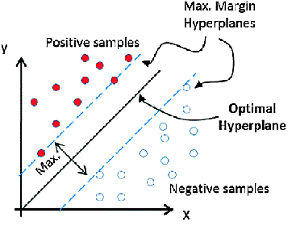
Support Vector Machine
Source - www.simplilearn.com

Slide 47
Support Vector Machine
Instead of using linear hyper planes, many implementations of these algorithms use so-called kernel functions.
Kernel
Kernel converts non separable problem to separable problems by adding more dimension to it. It is most useful in non-linear separation problem. Kernel trick helps you to build a more accurate classifier.
Polynomial Kernel
Gaussian Kernel
Sigmoid Kernel
Radial Basis Function Kernel

Slide 48
Decision Tree
The decision tree algorithm tries to solve the problem, by using tree representation.
Decision Tree calculates the probability that a given record belong to each of the category.
Decision Tree splits the sample into two or more homogeneous sets based on most significant differentiator in input variables.
Each internal node of the tree corresponds to an attribute or feature, and each leaf node corresponds to a class label.

Slide 49
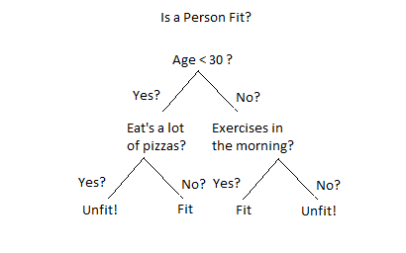
Decision Tree

Slide 50
Random Forest
The random forest classifier is ensemble algorithm.
Ensembled algorithms are those which combines more than one algorithms of same or different kind for classifying data.
Random forest classifier creates a set of decision trees from randomly selected subset of training set.
Then it aggregates the votes from different decision trees to decide the final class of the test data.
It predicts based on the majority of votes from each of the decision trees made.
Random Forest works well than decision tree because it reduces noise and aggregates votes of many decision trees for accurate results.

Slide 51
Evaluation Measure
For Evaluation Measure:
The most widely used evaluation measures, i.e. accuracy and F1 measures. The accuracy can be expressed as the ratio of correctly predicted instances to total instances.
Accuracy = number of messages whose author was correctly identified
total number of messages

Slide 52
Evaluation Measure
For Evaluation Measure:
Accuracy = (TP + TN)
(TP + TN + FP + FN)
where TP is defined as number of true positives i.e. correctly classified positive instances,
TN is defined as the number of true negatives i.e. correctly classified negative instances,
FP is defined as the number of false positives i.e. incorrectly classified negative instances and
FN is defined as number of false negatives i.e. incorrectly classified positive instances

Slide 53
Accuracy results with different models
Model | Gender | Age | Combine
Support Vector Machine | 91.43 | 61.43 | 50.00
Naïve Bayes | 80.0 | 57.14 | 34.28
Random Forest | 78.57 | 58.57 | 41.43
Decision Tree | 74.29 | 54.29 | 34.28

Slide 54
Accuracy results of different models with Unigram, Bigram, Trigram for Gender
Model | Unigram | Bigram | Trigram
Support Vector Machine | 91.43 | 85.71 | 78.57
Naïve Bayes | 80.0 | 65.71 | 60.0
Random Forest | 78.57 | 72.85 | 68.57
Decision Tree | 74.29 | 64.29 | 65.71

Slide 55
Accuracy results of different models with Unigram, Bigram, Trigram for Age
Model | Unigram | Bigram | Trigram
Support Vector Machine | 61.43 | 59.14 | 57.14
Naïve Bayes | 57.14 | 50.0 | 45.71
Random Forest | 58.57 | 57.14 | 55.71
Decision Tree | 54.29 | 54.29 | 52.86

Slide 56
Accuracy results of different models with Unigram, Bigram, Trigram for age and gender combine
Model | Unigram | Bigram | Trigram
Support Vector Machine | 50.00 | 45.71 | 42.86
Naïve Bayes | 34.28 | 27.14 | 27.14
Random Forest | 41.43 | 37.14 | 31.43
Decision Tree | 34.28 | 35.86 | 32.86

Slide 57
Sr. No. | Paper Title | Author | Journal | Summary
1 | Author Gender Identification from text | Na Cheng, R.Chandramauli,K.P subbalakshmi. | Digital Investigation, 2011 - Elsevier | Methods:- Support Vector Machine, Logistic Regression and AdaBoost Decision Tree Accuracy:- Gender - 83%
2 | Identifying Gender From SMS Text Messages | Shannon Silessi, Cihan Varol | 15th IEEE Conference on Machine Learning and Application | Methods:- Support Vector Machine, Logistic Regression Accuracy:- Gender - 72.39%
3 | Use of Language and Author Profiling: Identification of Gender and Age | Francisco Rangel, Paolo Rosso | Natural Language Processing and Cognitive 2013 | Methods:- stylistic features with Support Vector Machine. Accuracy:- Gender - 77.87%
4 | Author Profiling: Predicting Age and Gender from Blogs | K Santosh, Romil Bansal, Mihir Shekhar, and Vasudeva Varma | Digital Investigation, 2013 - Elsevier | Methods:- Content-based, Style-based, and Topic-based. Accuracy:- Gender - 56.53% Age - 64.8%
5 | Inferring Gender of Movie Reviewers | Jahna Otterbacher | 19th ACM international conference | Methods:- Logistic Regression. Accuracy:- Gender - 73.7%

Slide 58
Sr. No. | Paper Title | Author | Journal | Summary
6 | Author Profiling in the wild | Lisa Kaati, Elias Lundeqvist, Amendra Shrestha and Maria Svensson | IEEE Explore | Methods:- Support Vector Machine Accuracy:- Gender - 56%
7 | Author Profiling on Facebook | Mehwish Fatima, Komal Hasan, Saba Anwar, Rao Muhammad Adeel Nawab | Information Processing 2017 - Elsevier | Methods:- Support Vector Machine, N-Gram Accuracy:- Gender - 87% Age - 75%
8 | Author Profiling for Blogs | Dang Duc Pham, Giang Binh Tran, Son Bao Pham | International Conference on Asian Languages Processing ieee expolre – 2009 | Methods:- Random Forest. Accuracy:- Gender - 80%
9 | Multilingual Author Profiling using Word Embedding Averages | Roy Bayot, Teresa Gonc¸alves | 10th International Conference on Software, Knowledge, Information Management & Applications (SKIMA) – 2016 | Methods:- Support Vector Machine, Accuracy:- Gender - 45.8% Age - 39.7%

Slide 59
Sr. No. | Paper Title | Author | Journal | Summary
10 | Multilingual SMS-based Author Profiling | Mehwish Fatima, Saba Anwar, Amna Naveed, Waqas Arshad, Rao Muhammad Adeel Nawab, Muntaha Iqbal and Alia Masood | Natural Language Engineering at Cambridge University Press - 2018 | Methods:- Support Vector Machine Accuracy:- Gender - 95%
11 | Language and Gender Author Cohort Analysis of E-mail for Computer Forensics | Malcolm Corney, Alison Anderson, George Mohay, Olivier De Vel | Digital Forensic Research Conference-2017 | Methods:- Support Vector Machine Accuracy:- Gender - 77.8%
12 | Automatically Profiling the Author of an Anonymous Text | Shlomo Argamon, Moshe Koppel, James W. Pennebaker | Communication of ACM-2011 | Methods:- Bayesian Multinomial Regression(BMR) Accuracy:- Gender - 42.7%
13 | Effects of Age and Gender on Blogging | Jonathan Schler, Moshe Koppel, Shlomo Argamon, James Pennebaker | Conference of Computational Approaches to Analysing Weblogs – Stanford, California, USA - 2006 | Methods:- Support Vector Machine Accuracy:- Gender - 67.3%

Slide 60
Sr. No. | Paper Title | Author | Journal | Summary
14 | Gender Prediction in English | Ankush Khandelwal, Sahil Swami, Syed Sarfaraz Akhtar and Manish Shrivastava | Cornell University Library Arxiv - 2018 | Methods:- Support Vector Machine Accuracy:- Gender - 75.7%
15 | Author Profile Prediction using Pivoted Unique Term Normalization | T. Raghunadha Reddy, B. Vishnu Vardhan and P. Vijayapal Reddy | Indian Journal of Science and Technology - 2016 | Methods:- Naïve Bayes Multinomial and The logistic Classifier Accuracy:- Gender – 68.5%
16 | Identifying the Authors of Suspect Email | Olivier De Vel, Malcolm Corney, Alison Anderson, George Mohay | Digital Forensic Research Conference-2017 | Methods:- Support Vector Machine Accuracy:- Gender - 73.7%
17 | Identifying Languages at the Word Level in Code-Mixed Indian Social Media Text | Amitava Das, Björn Gambäck | 11th International Conference on NLP International Institute of Information Technology Goa, India-2014 | Methods:- Naïve Bayes Multinomial and The logistic Classifier Accuracy:- Gender - 68.5%
18 | N-gram approach for gender prediction | T Raghunadha Reddy, B Vishnu Vardhan, P Vijayapal Reddy | IEEE 7th International Advance Computing Conference-2017 | Methods:- Naive Bayes Multinomial and Logistic classifiers Accuracy:- Gender - 63.2%

Slide 61
Conclusion
We have obtained the highest accuracy using SVM that is for gender we obtained 91.43% and for age 61.43% and combine 50% accuracy.
We have tried till trigram, as our accuracy got reduced after trigram approach.
We observed that decision tree performed poor for combine accuracy.

Slide 62
Future Work
Collecting more author profiles to increase the size of dataset.
We aim to extend model by deep learning techniques.
So far our dataset contained two languages but in the future, it would be beneficial to include more South Asian languages as they are relatively less explored and contain potential to be very useful.
We would like to demonstrate other author traits like native language, native area, personality, type, qualification and occupation.

Slide 63
References
Fatima, M., Hasan, K., Anwar, S., Nawab, R.-M.-A.: Multilingual author profiling on Facebook. Information Processing & Management 53(4), 886-904 (2017).
Monika Briediene, Jurgita Kapociute Dzikiene.: An Automatic author profiling from Non-Normative Lithuanbian Texts(2014).
Fransisco Rangel, Paolo.: On the impact of emotions on author profiling. Information Processing and Management 52(2016)73-92.
Murat Karabatak, Shannon Silessi, Cihan Varol : Identifying Gender From SMS Text Messages at 2016 15th IEEE International Conference on Machine Learning and Applications.
Jahna Otterbacher: Inferring Gender of Movie Reviewers at 19th ACM international conference.
K Santosh, Romil Bansal, Mihir Shekhar, and Vasudeva Varma : Author Profiling: Predicting Age and Gender from Blogs at CLEF 2013.
Jonathan Schler, Moshe Koppel, Shlomo Argamon, James Pennebaker : Effects of Age and Gender on Blogging at Conference of Computational Approaches to Analysing Weblogs – Stanford, California, USA – 2006.
Hernandez, D., Guzman-Cabrera, R., Reyes, A., Rocha, M.-A.: Semantic-based Features for Author Profiling Identification: First insights. In: Proceedings of CLEF, (2013).

Slide 64
References
Nguyen, D., Gravel, R., Trieschnigg, D., Meder, T.: “How Old Do You Think I Am?” A Study of Language and Age in Twitter in 7th International AAAI Conference on Weblogs and Social Media ICWSM (2013).
Fransisco Rangel, Paolo: Use of Language and Author Profiling: Identification of Gender and Age in Natural Language Processing and Cognitive (2013).
T. Raghunadha Reddy, B. Vishnu Vardhan and P. Vijayapal Reddy: Author Profile Prediction using Pivoted Unique Term Normalization in Indian Journal of Science and Technology (2016).
“Text Categorization with Support Vector Machines: Learning with Many Relevant Features” 2008 – Springer.
https://scikit-learn.org/stable/modules/svm.html
https://scikit-learn.org/stable/modules/feature_extraction.html
https://pandas.pydata.org/pandas-docs/stable/generated/pandas.read_csv.html
https://towardsdatascience.com/decision-tree-ensembles-bagging-and-boosting-266a8ba60fd9

Slide 65


